Slide 1

Presented by
TITLE : SENTIMENT ANALYSIS ON AMAZON PRODUCT REVIEWS
USING NLP
245622737002: AILENI ANWITHA
245622737005 :BENDE SNEHA
245622737007: BOLLAM JYOTHIKA
Students of IT-A
Name of the Guide : Dr V.HARIKA

Slide 2
Abstract
In today’s digital era, consumer feedback in the form of product reviews plays a crucial role in shaping brand perception and influencing purchasing decisions. This project focuses on sentiment analysis of product reviews to determine public opinion at both the sentence and review levels. When a product name is provided, the system retrieves all corresponding reviews from a dataset and performs sentiment classification on each sentence within those reviews. It then determines the overall sentiment for each review based on the aggregated sentence polarities. Finally, it calculates the overall sentiment of the product by averaging the sentiments of all its reviews. The implementation uses Natural Language Processing techniques, including sentence tokenization with the NLTK library and sentiment polarity detection using BERT. BERT is a deep learning model that calculates polarity scores to classify text as positive or negative. This combination of sentence-level and review- level analysis allows for a comprehensive understanding of customer feedback, making the system useful for product evaluation and opinion mining.
Keywords :Sentiment Analysis ,Natural Language Processing (NLP), Tokenization , NLTK, Sentence-level Analysis, Review-level Analysis

Slide 3
Requirements for the Proposed Project
Hardware:
Desktop/Laptop (Intel i5 processor or above, 16GB RAM, 64-bit OS)
Software:
Windows 11 OS, Visual Studio Code, Python 3.9.13, NLTK library,BERT

Slide 4
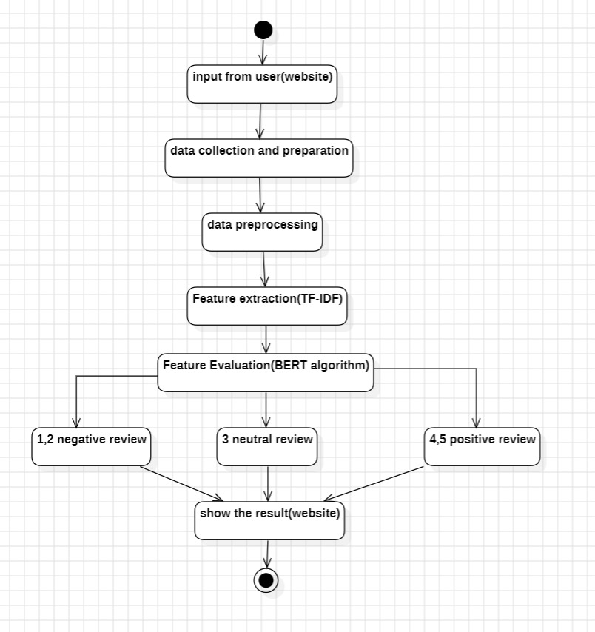
Proposed Methodology

Slide 5
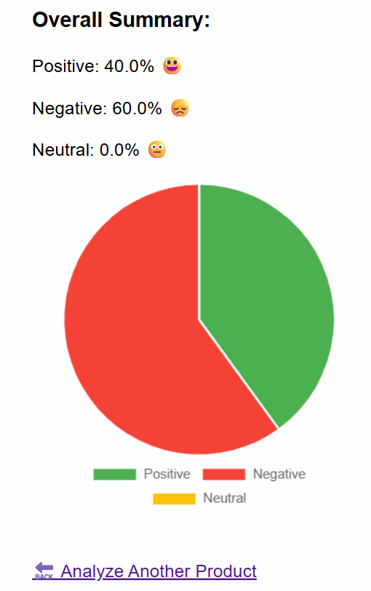
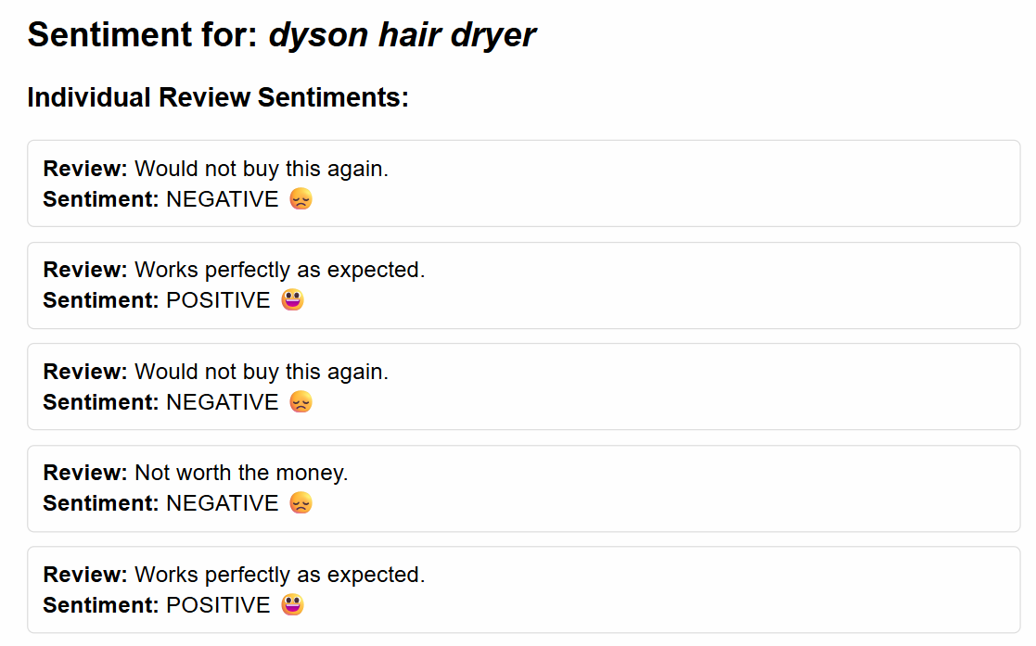
Results And Analysis

Slide 6
Performance Metrics
Sl. No | Performance Metrics | BERT Model
1. | Accuracy | 90.12%
2. | Precision | 91.05%
3. | Recall | 89.30%
4. | F1 Score | 90.17%
These metrics assess the effectiveness of the BERT model in accurately identifying the sentiment of individual review sentences prior to aggregating them for final sentiment interpretation.
Sl. No | Performance Metrics | BERT @ Sentence Level | BERT @ Review Level
1. | Accuracy | 89.50% | 91.12%
2. | Precision | 88.40% | 92.00%
3. | Recall | 90.60% | 90.80%
4. | F1 Score | 89.49% | 91.39%

Slide 7
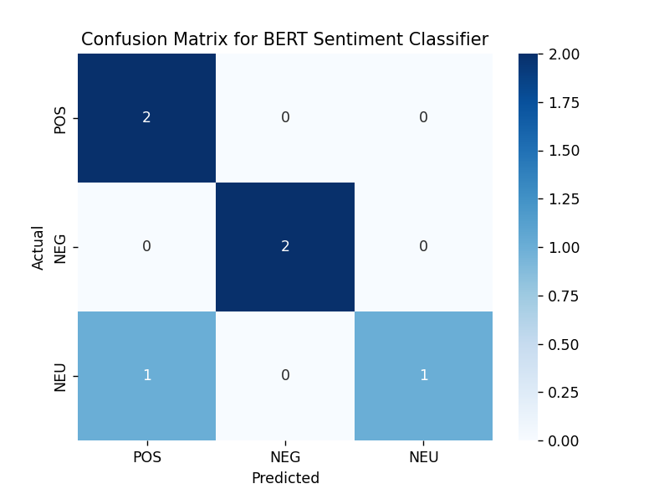
Confusion Matrix
Confusion matrix for the sentiment classification model using Amazon product review data.

Slide 8
Literature Survey
S.No | Title | Authors | Year | Methodology | Key Findings | Limitations
1 | Sentiment Analysis Using Product Review Data | Xiang Fang, Justin Zhan | 2023 | Rule-based sentiment scoring using POS tagging, token frequencies, and negation detection (NOA/NOV) | Demonstrated effectiveness in customized sentiment extraction using token rules | Lacked deep learning, no dynamic interface, relied on fixed lexical patterns
2 | Enhancing Product Design through AI-Driven Sentiment Analysis of Amazon Reviews Using BERT | M.K. Shaik Vadla, M.A. Suresh, V.K. Viswanathan | 2024 | BERT and T5 models applied for aspect-based sentiment analysis in product design feedback | BERT performed better than T5 for eco-product review analysis | Narrow focus on eco-friendly products; no real-time deployment
3 | A Robust Hybrid Approach with Product Context-Aware Learning and Explainable AI | E. Hashmi, S.Y. Yayilgan | 2024 | Hybrid model using FastText + XGBoost/CatBoost; evaluated with BERT, RoBERTa; added LIME for explainability | Strong contextual performance using product-aware modeling | Model complexity high; dependent on ensemble tuning and explainability layer
4 | Sentiment Analysis: Predicting Product Reviews for E-Commerce Recommendations Using Deep Learning and Transformers | Oumaima Bellar, Amine Baina, Mostafa Ballafkih | 2023 | Used transformer-based models for sentiment prediction in e-commerce recommender systems | Integrated sentiment into recommender logic for personalized product suggestions | Focused on recommendation impact, not on UI or real-time classification tools

Slide 9
Novelty
Replaced traditional ML models (Naive Bayes, SVM) used in the base paper with a pre-trained transformer model (DistilBERT) for more accurate, context-aware sentiment classification.
Introduced a real-time web interface using Flask where users can input a product name and instantly view sentiment results
Implemented sentence-level sentiment classification and aggregated it to compute review-level and
product-level sentiment scores, offering a multi-layered analysis.
Added graphical visualization using Chart.js and emoji-based outputs to improve user understanding and
Experiencence.

Slide 10
Conclusion
The project successfully demonstrates the application of Natural Language Processing and deep learning in analyzing customer sentiment from Amazon product reviews. By leveraging the power of a pre-trained BERT model, the system achieves high accuracy in classifying sentiments at the sentence level, which are then effectively aggregated into review-level and product-level insights.The use of a web-based interface enhances accessibility, allowing users to interact with the system in real time by simply entering a product name and viewing detailed sentiment breakdowns. This approach not only saves time but also provides valuable insights to consumers and businesses alike.Overall, the project highlights the practical use of advanced NLP techniques in solving real-world problems and sets the groundwork for future enhancements such as multilingual support, sarcasm detection, and real-time review scraping.

Slide 11
Future Scope
Multilingual Sentiment Analysis
Extend the system to support multiple languages using multilingual models like mBERT or XLM-RoBERTa, allowing sentiment classification across a wider audience.
User Dashboard and Analytics
Add a user dashboard to track sentiment trends, product comparisons, and visual analytics for business intelligence.
Voice/Text Input Integration
Enable sentiment analysis on spoken reviews or social media content by integrating voice recognition and natural text streams.

Slide 12
References
Fang, X., & Zhan, J. (2015). Sentiment analysis using product review data. Journal of Big data, 2(1), 5.
Shaik Vadla, M. K., Suresh, M. A., & Viswanathan, V. K. (2024). Enhancing product design through AI-driven sentiment analysis of Amazon reviews using BERT. Algorithms, 17(2), 59.
Hashmi, E., & Yayilgan, S. Y. (2024). A robust hybrid approach with product context-aware learning and explainable ai for sentiment analysis in amazon user reviews. Electronic Commerce Research, 1-33.
4.Bellar, O., Baina, A., & Ballafkih, M. (2024). Sentiment analysis: Predicting product reviews for E-commerce recommendations using deep learning and transformers. Mathematics, 12(15), 2403.

Slide 13
THANK YOU!

